Slide 1
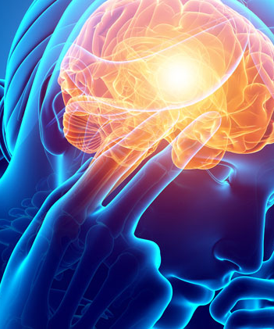
DS - 675 - 005
Predicting Brain Stroke Using Neural & Non-Neural Network
Predict the occurrence of a brain stroke based on patient health data.
Prepared By
Krupa Lakhani - (kgl), Deep Patel - (djp223), Joy Patel - (jp2267)
Instructed By
Dr. Mengjia Xu

Slide 2
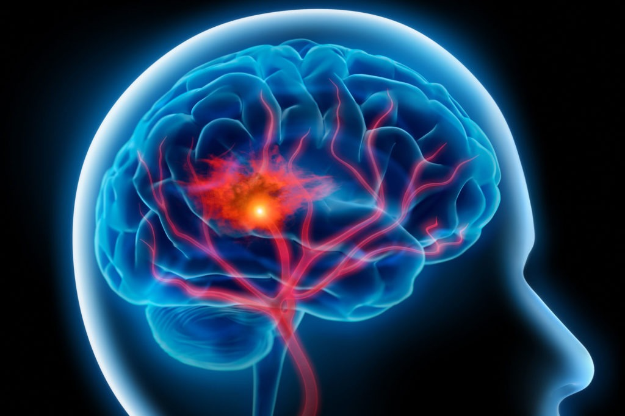
Agenda
Introducrion
Motivation
Problem Statement
Approach
Data Overview
Classifiers
Model Training Process
Feature Impacts
Model Evaluations
Key Findings
Model Prediction Result
Conclusion
Reference
"A stroke, sometimes called a brain attack, occurs when something blocks blood supply to part of the brain or when a blood vessel in the brain bursts."

Slide 3
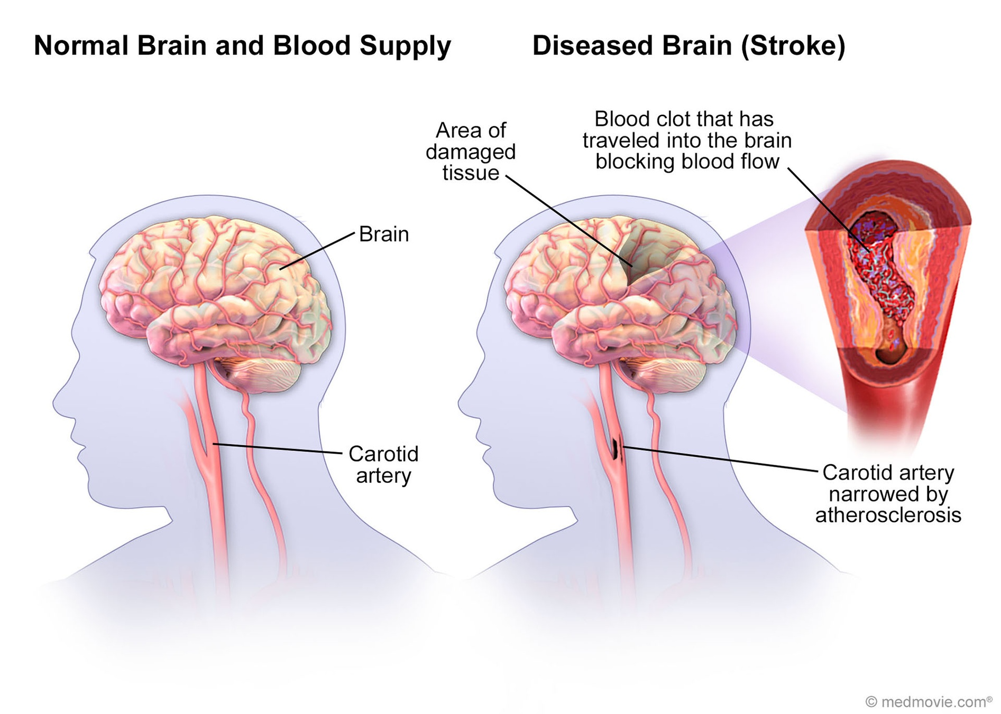
Introduction
What is Brain Stroke ?
A brain stroke occurs when the blood supply to part of the brain is interrupted or severely reduced, depriving brain tissue of oxygen and nutrients. This can cause brain cells to die. A stroke is a medical emergency and can cause permanent damage, complications, and death.

Slide 4
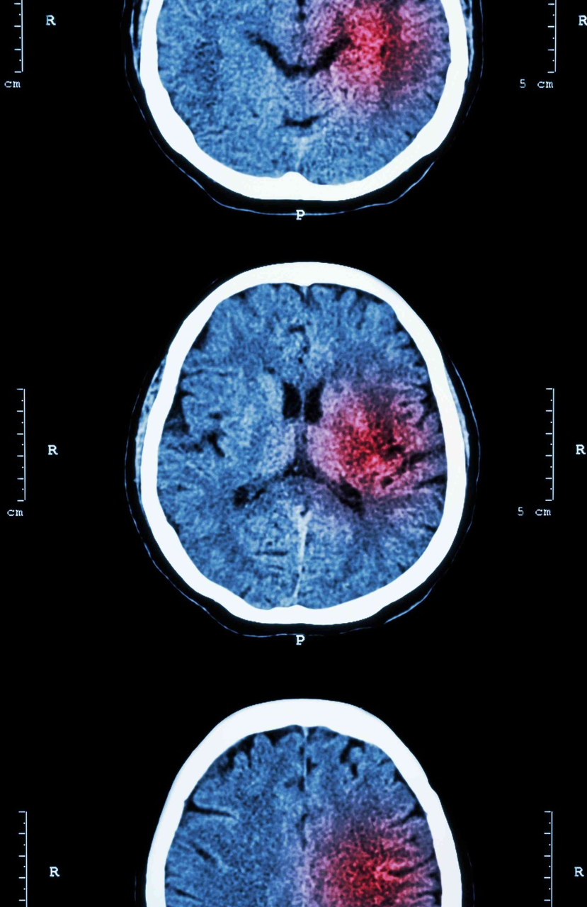
Motivations
Brain stroke prediction is an important area of medical research. Accurate models can help doctors identify patients at risk of stroke and provide preventive care. This overview introduces key concepts in stroke prediction and the need for precise algorithms.

Slide 5



Problem Statement
Quantifying factors that predict stroke occurrence
Developing a statistical model for prediction
Validating model accuracy
Evaluating model performance on new datasets to ensure accurate stroke predictions
Identifying the key factors from patient data that are most predictive of stroke occurrence
Leveraging patient datasets to build a statistical model that can predict stroke likelihood
By identifying the top factors for stroke prediction and developing an accurate statistical model, we can enable better prevention and care for patients at high stroke risk.

Slide 6


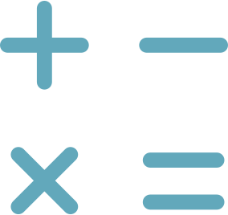

Approach
Data collection and preprocessing
Exploratory data analysis
Model development with machine learning algorithms
Model evaluation and optimization
Analyzing dataset using visualizations to find insights and correlations
Gathering the dataset and cleaning it by handling missing values and imputing them
Evaluating models on test data and tuning hyperparameters for improved performance
Neural Network such as MLP & other traditional classifier
Systematic process to develop a predictive model for brain stroke using machine learning on healthcare data

Slide 7


Data Overview
Feature
Value
Number of Observations
5110
Number of Features
12
Target Variable
Stroke Status (Yes/No)
*Dataset from Kaggle

Slide 8
Classifiers
Logistic Regression
Decision Trees
Random Forests
Worst classifer
Resulted In 220 false negative and 320 false positive
Identifies key Risk factors
Binary outcomes
Cart algorithm
Partition the cases into branches
Based on highest gain attribute
Having precision of 87%
Ensemble method
Best hyperparameters tunning
Best prediction
Precision of 98%
Number of estimators 200
MLP - Neural Networks
XGBoost
KNN
Adam Optimizer
Binary Cross Entropy Loss
Drop Out of 10%
Early Stopping at 52 Epoch
1,81,249 Parameters
Gradient boosting framework
Precision of 95%
Optimizes cost function
Max_Depth of 7
Number of estimator 200
Used Ball tree algorithm
Number of neighbours = 9
Euclidean distance = 2
Weights are consider as distance
Precision of 94%

Slide 9



Model Training Process
Data Preprocessing
Model Definition
Model Training
Model Evaluation
Model Tuning
Model Saving
Clean and preprocess the data by handling missing values, converting categorical variables to numeric, splitting into training and validation sets.
Define a multilayer perceptron model with input, hidden and output layers. Specify activation functions, loss function and optimizer.
Train the model by iterating through batches of training data. Track model accuracy on validation set.
Evaluate model performance using metrics like accuracy, precision, recall. Identify areas for improvement.
Tune hyperparameters like learning rate, layers, units etc. to improve model performance.
Save the final trained model to file for future use.

Slide 10
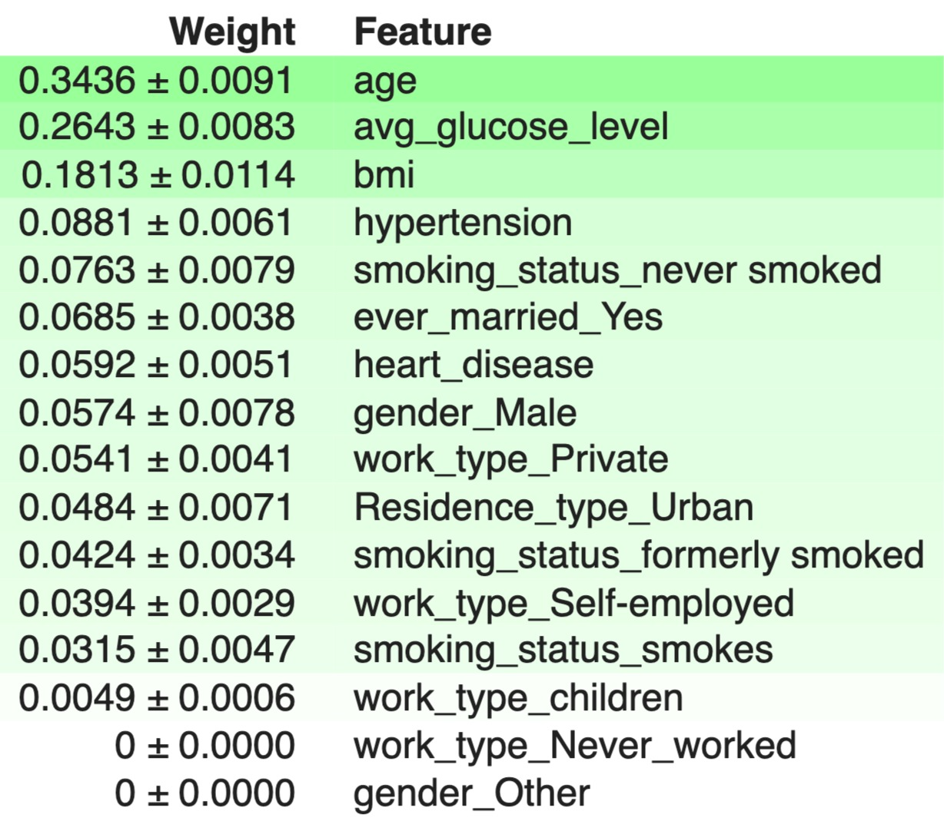
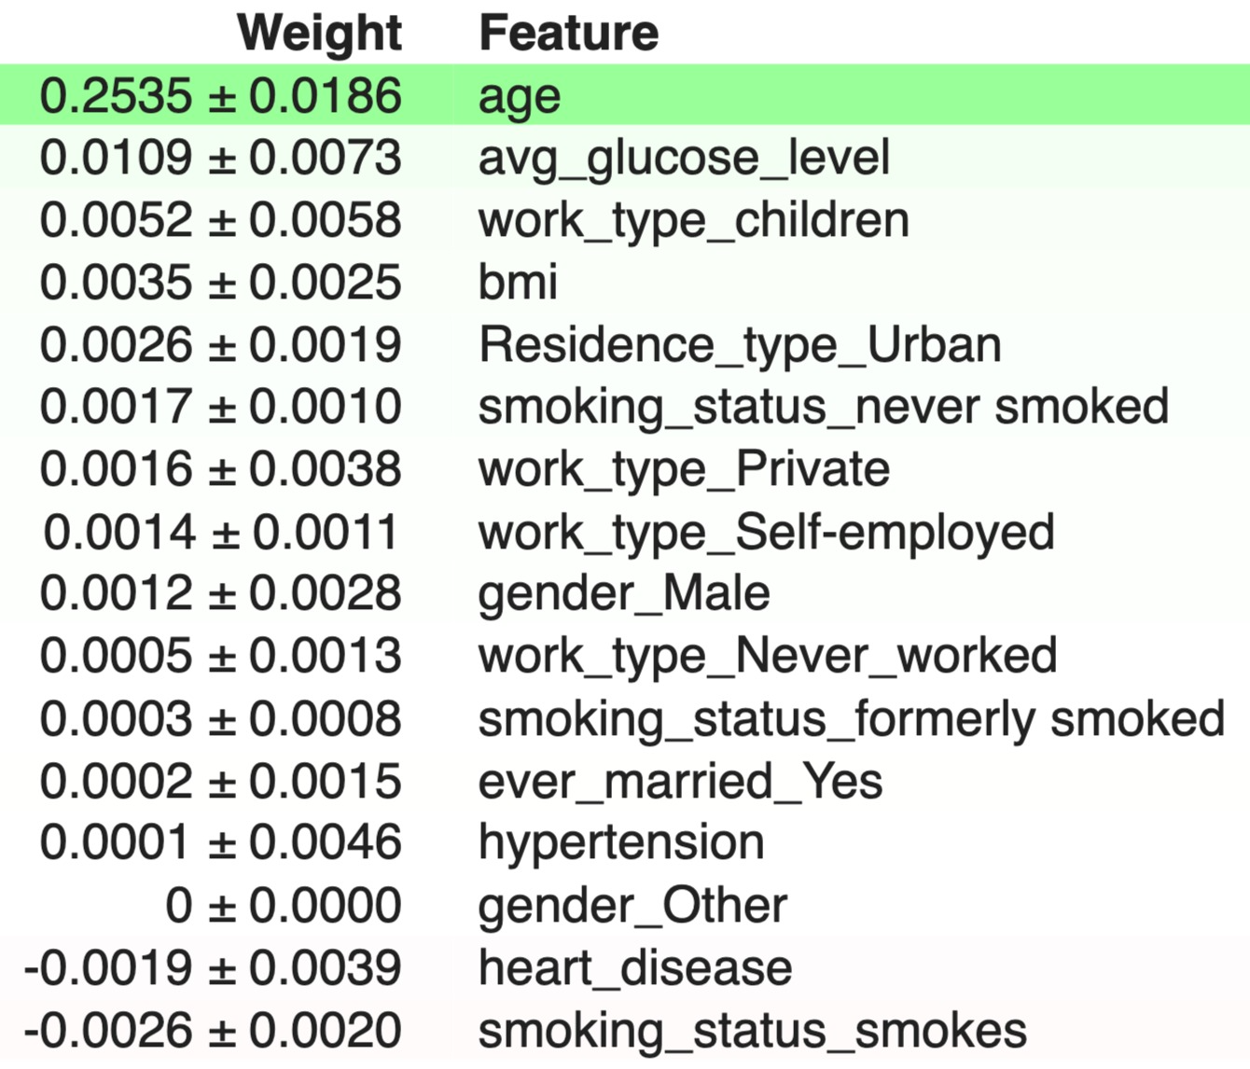
Feature Impact (Permutation Importance)
The RandomForest classifier: age is important feature of this model. Looking at the feature selection. Work_type is least important in this model. But it considers Bmi and hypertension are important unlike LR model. Thus this model performs best predictions.
The Logistic Regression model: age is important feature of this model. Looking at the feature selection. Bmi and Hypertension are least important in this model unlike other models where these features are equally important. Thus this model performs worst predictions.

Slide 11



Hyperparameters Tuning
MLP
XGBoost
Number of hidden layers are three, and neurons(units). We have used Relu as an activation function for all the layers accept the last layer which has Sigmoid. Loss function is binary cross entropy. Batch size is 256 and 100 epochs. Drop out regularization of 10% after each layer. We used a early stopping method for more accurate predictions. For the most accurate prediction the model stops training at 52 out of 100 epochs.
We used GridSearchCV to iterate over all the hyperparameters and find the best fit from these. The result gives maxdepth of 7, and estimators equal to 200.
Random Forest
Used GridSearchCV and found Max_depth = 30, max_ feature = srqt , min_sample_leaf = 1, min_sample_split = 2, number of estimators = 2.
Unlike MLP, We have used GridSearch CV for hyperparameters tuning for all the classifiers. The best result we derived was from XGBoost and Random Forest.

Slide 12
Model Evaluation
Comparison of accuracy metrics from 0-100
87.0%
90.7%
96.3%
97.9%
99.8%
78.3%
Logistic Regression
Decision Tree
K-Nearest Neighbours
Multilayer Perceptron
XGBoost
Random Forest

Slide 13



Key Findings
- Age is a top risk factor
- Hypertension increases risk
- Random forest algorithm has highest accuracy
The model found that increased age is highly correlated with stroke risk.
Having hypertension or high blood pressure was also identified as a major risk factor.
Among the machine learning models tested, the random forest algorithm achieved the best predictive performance with 82% accuracy.
In summary, the key findings demonstrate that advanced age and hypertension are critical risk factors for stroke that can be used to build an accurate predictive model using machine learning.

Slide 14
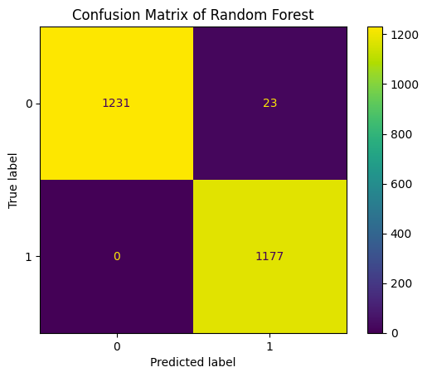
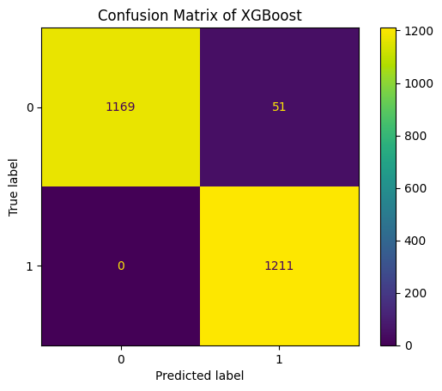
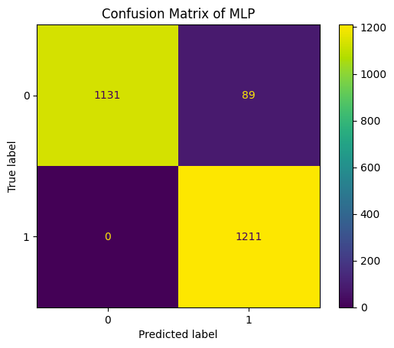

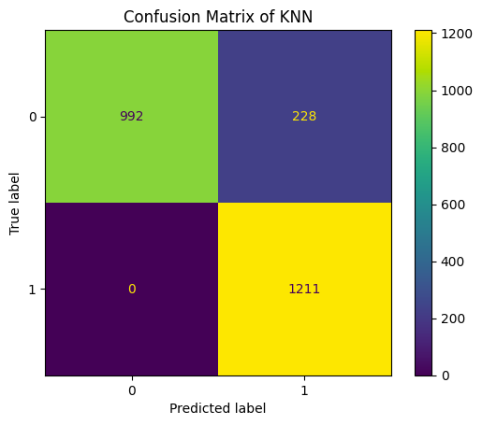
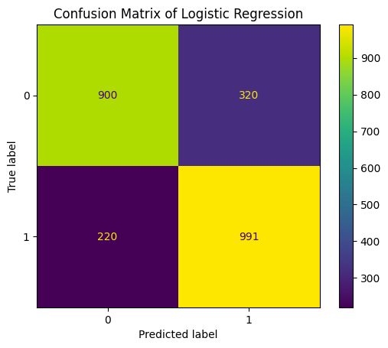
Model Prediction Results (Confusion Matrices)

Slide 15
Conclusions
MLP and XGBoost is effective for stroke prediction
Important predictors identified
Model can enable preventive healthcare
The MLP model achieved high accuracy in predicting stroke occurrence, demonstrating its effectiveness for this task.
Key predictors like age, bmi, hypertension, heart disease, and glucose level were identified as most informative for stroke prediction.
The random forest model can be operationalised to identify patients at high stroke risk and enable preventive healthcare.
Smote analysis can improve performance
Other models can be explored
Roc & AUC Score
Random Forest demonstrates proficiency in classifying data, particularly with incomplete attributes and large sample sizes. It excels in obtaining a perfect ROC and AUC score of 0.99, along with a Precision of 0.98.
Smote analysis could further improve model performance and ability to identify at-risk patients.
Testing other ML models like SVM, stacking classifier could reveal even better approaches for stroke prediction.

Slide 16
References
[1] Reference Paperhttps://ieeexplore.ieee.org/document/9734197
[2] Kaggle Notebook Reference, used in Milestone 2. https://www.kaggle.com/code/alexisbcook/categorical-variables
[3] Kaggle Notebook Reference, Data Cleaning https://www.kaggle.com/code/dansbecker/handling-missing-values
[4] Applying SMOTE.https://imbalanced-learn.org/stable/references/generated/imblearn.over_sampling.SMOTE.html
[5] Permutation Importance https://www.kaggle.com/code/dansbecker/permutation-importance
[6] MLP. https://learnopencv.com/implementing-mlp-tensorflow-keras/
[7] Cross Validationhttps://www.kaggle.com/code/alexisbcook/cross-validation
[8] KNNhttps://www.kaggle.com/code/amolbhivarkar/knn-for-classification-using-scikit-learn
[9] XGBoost classifierhttps://www.kaggle.com/code/alexisbcook/xgboost
[10] Random Forest Classifierhttps://www.kaggle.com/code/dansbecker/random-forests
[11] Decision Treehttps://www.kaggle.com/code/stieranka/decision-trees
[12] Logistic Regressionhttps://scikit-learn.org/stable/modules/generated/sklearn.linear_model.LogisticRegression.html
These are the key references and data sources for the presentation on predicting brain stroke.

Slide 17

Thank You

